Slide 1
CONTINUITY & DIFFERENTIABILITY
MD. SHAHADAT HOSSAIN
shahadatmathku@gmail.com

Slide 2
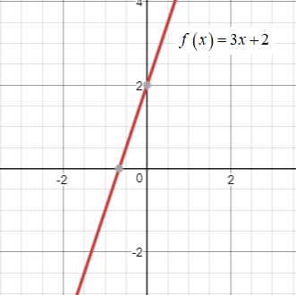
Continuity and Differentiability
Continuity
A function is continuous only when

Slide 3
Continuity and Differentiability
Differentiability
A function is differentiable at a point x = a, if it is continuous for each real value of x.
And
To be differentiable, a function must be smooth.
From the previous problem

Slide 4
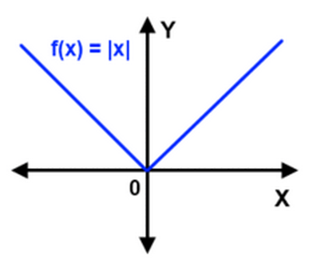
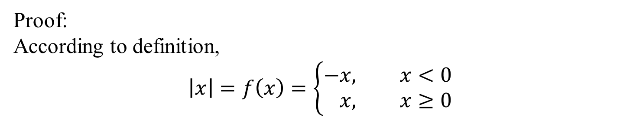
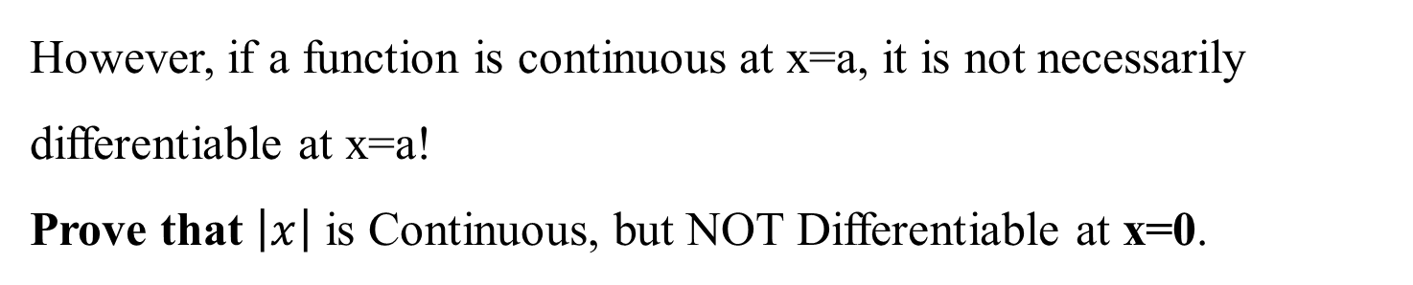
Continuity and Differentiability
Differentiability
However, if a function is continuous at x=a, it is not necessarily differentiable at x=a!
Prove that $\left|x\right|$ is Continuous, but NOT Differentiable at x=0.
Proof:
According to definition,
$$\left|x\right|=f\left(x\right)=\left\{\begin{aligned}−&x, x<0 \\ &x, x≥0\end{aligned}\right.$$

Slide 5
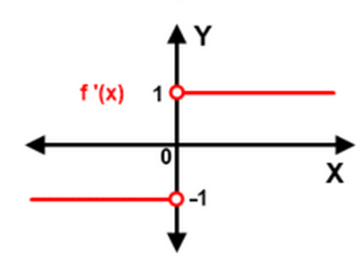
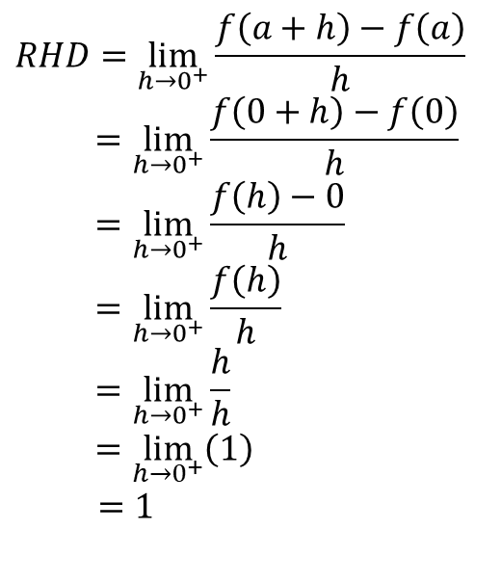
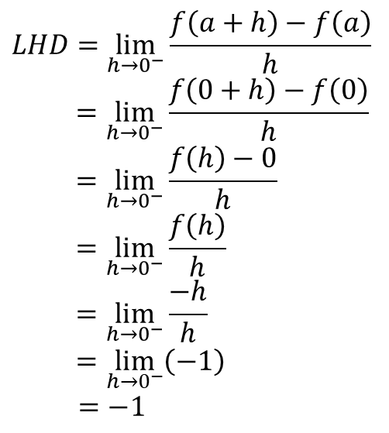
Continuity and Differentiability
Differentiability
$$LHD=\lim_{h→0^{−}}{\frac{f\left(a+h\right)−f\left(a\right)}{h}}$$
$$=\lim_{h→0^{−}}{\frac{f\left(0+h\right)−f\left(0\right)}{h}}$$
$$=\lim_{h→0^{−}}{\frac{f\left(h\right)−0}{h}}$$
$$=\lim_{h→0^{−}}{\frac{f\left(h\right)}{h}}$$
$$=\lim_{h→0^{−}}{\frac{−h}{h}}$$
$$=\lim_{h→0^{−}}\left(−1\right)$$
$=−1$
$$RHD=\lim_{h→0^{+}}{\frac{f\left(a+h\right)−f\left(a\right)}{h}}$$
$$=\lim_{h→0^{+}}{\frac{f\left(0+h\right)−f\left(0\right)}{h}}$$
$$=\lim_{h→0^{+}}{\frac{f\left(h\right)−0}{h}}$$
$$=\lim_{h→0^{+}}{\frac{f\left(h\right)}{h}}$$
$$=\lim_{h→0^{+}}{\frac{h}{h}}$$
$$=\lim_{h→0^{+}}\left(1\right)$$
$=1$
$∴\left|x\right|$ is Continuous, but NOT Differentiable at x=0.

Slide 6
Continuity and Differentiability
Differentiability
Prove that Derivatives will fail to exist at:
corner
cusp
vertical tangent
discontinuity

Slide 7


